Slide 1
Screening and Interviewing
Pub 4012 – Tab B
Pub 5101 – Intake/Interview And Quality Review Training

Slide 2
Lesson Topics
Interview process
Intake Booklet
Consents
Questions
Due diligence

Slide 3
Engage the Taxpayer
Put taxpayers at ease
Build rapport
Introduce yourself with a smile
Engage in small talk
Ask open-ended questions
Questions that require more than yes or no answers
This is not an adversarial relationship

Slide 4
Engage the Taxpayer
Speak clearly
Allow taxpayer time to respond
Protect taxpayer privacy
Don’t be afraid to say, “Let me check that for you”
Always ask permission to discuss taxpayer information with another counselor

Slide 5
Explain the Process
Examine taxpayer ID, Intake Booklet, tax documents, and prior year return
Ask questions to help clarify taxpayer situation
Determine tax return is in scope
Tax data entered into computer
Return reviewed by a second certified counselor
Explain reviewer also asks questions for verification
Notes:
Make sure taxpayer understands the steps you will follow that lead to his/her return being completed

Slide 6
Explain the Process (cont.)
Copy printed for taxpayer (mail-in copies when required)
Taxpayer reviews return(s) for accuracy and completeness
Explain taxpayer is responsible for their tax return
Taxpayer/spouse sign return
Federal (state if applies) return E-filed (mailed by taxpayer only if IRS requirement)
Taxpayer keeps all documents, including signed copies
Tax-Aide keeps no taxpayer data or documents
Notes:
Make sure taxpayer understands the steps you will follow that lead to his/her return being completed
Review of Intake Booklet and documents and last year’s return to make sure have everything and return is in scope
Data entry in TaxSlayer – will likely have questions as go through this
Your review of completed return with taxpayer – he/she knows better than anyone if spellings are correct, addresses correct, etc. plus chance to answer any questions
QR by a second set of eyes to make sure everything is correct
Will give copies of returns to taxpayer for their records
Will efile federal and state returns (unless there is a tax law related reason not to – we don’t prepare paper returns otherwise)
Will give them any local returns to mail if necessary

Slide 7
Confirm Taxpayer Identity
Confirm identity of taxpayers with government-issued photo ID
LC approval required for exceptions
Confirm taxpayer identification number for every person listed on return
Social Security card or 1099-SSA benefits statement
ITIN letter
LC approval required for exceptions
Notes:
Be cognizant of IDENTITY THEFT!
Screening may be done initially by the client facilitator, but the trained counselor must ALSO complete this step.
If taxpayer and spouse are known by counselor and identity can be verified by counselor, that is acceptable.

Slide 8
Screening and Interviewing
Thorough screening and interview required prior to starting return
Review all pages of Intake Booklet with taxpayer
Ensure return is in scope
Ask questions when situation unclear
Exercise due diligence
Discuss/review consents and questions
Notes:
Good interview will determine if return is in scope
Saves taxpayer and Counselor time

Slide 9
Tax Documents
Sort taxpayers’ documents in order of 1040
Wages
Interest
Dividends
Social Security
IRA distributions and pensions
Brokerage statements
Deductions, adjustments, or credits
Notes:
The counselor’s job is not just to input the taxpayer’s documents – it is to ensure they are preparing an accurate and complete tax return for the taxpayer
Sort and stack documents in Form 1040 order and leave in order for Quality Reviewer

Slide 10
Tax Documents (cont.)
Confirm needed documents and information present
Taxpayer may need to go home for missing information
Verify tax year
Review for scope
Is the document in scope?
Are all the box entries and codes on the document in scope?
Refer to AARP Foundation Tax-Aide Scope Manual
Notes:
Taxpayers sometimes mix multiple years of documents, so be sure to use only current year

Slide 11
Intake Booklet
Comprised of 8 bound pages:
Pages 1-3: IRS Interview/Intake Sheet
Page 4: AARP Demographic Questions
Page 5: Divider/Instructions Page
Page 6: IRS Global Carry Forward Consent Form
Page 7: Relational Offices Consent Form
Page 8: Information Sharing with AARP Foundation Consent Form
Notes:
Instructor should hand out copies of Intake Booklet to learners, so they can review together and learners can make notes

Slide 12
Intake Booklet
First three pages similar to prior years
Counselors complete gray shaded areas
Discuss and change all “Unsure” to “Yes” or “No”
Review Intake Booklet for out of scope items or items requiring additional certification
Add notes on Intake Booklet of any additional information to assist quality reviewer
Notes:
Some taxpayers may have difficulty answering all the questions.
Client Facilitator can help
You will help as you review all questions and entries

Slide 13
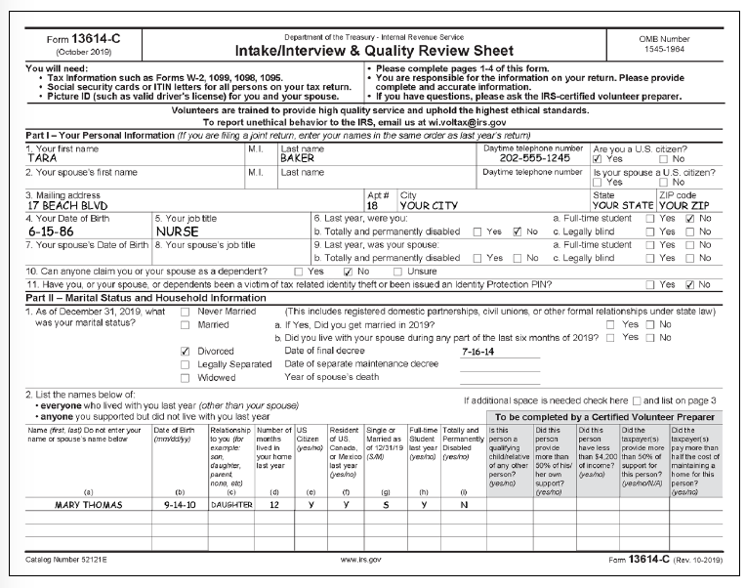
Intake Booklet Page 1
Counselor to complete shaded area
What questions would you ask?
Notes:
This is a must to verify that the counselor has checked whether this person is a dependent, or qualifies the taxpayer for any other credits
Possible questions to ask to determine eligibility for credits:
How much money does this person earn?
Does this person have other income? (interest, dividends, trust income)
Does anyone else support this person?
Could anyone else claim this person?
Does this person use their income to support themselves?

Slide 14
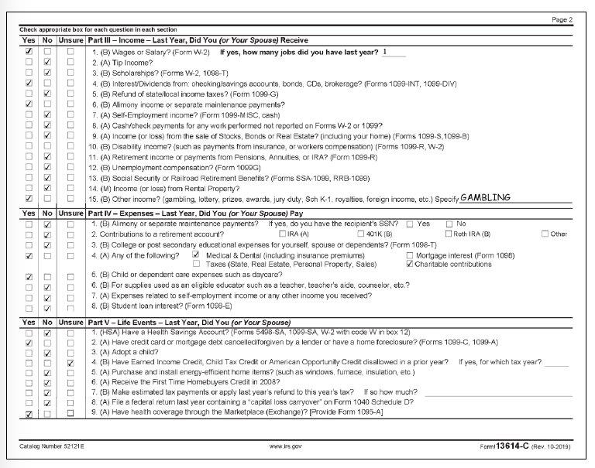
Intake Booklet Page 2
Health Coverage question now on page 2

Slide 15
Consent #1: IRS Global Carryforward Consent
Consent to Disclose Tax Return Information to VITA/TCE Tax Prep Sites
Allows TaxSlayer to carryforward taxpayer data to all active TCE/VITA Sites following year
Reduces time and errors if taxpayer switches to different site the following year
Taxpayer/spouse sign form if agree to consent
Notes:
We would like taxpayers to sign this consent. If taxpayer goes to different Tax-Aide site to get their taxes prepared next year, this allows the new site to have carryforward of basic data. The previous year’s tax return is not carried to another site.
Both taxpayer and spouse must sign consent. If one denies, consent is denied. Taxpayer may take consent home with Form 8879 to secure signatures.

Slide 16
Consent #2: Relational Offices Consent
Consent to Disclose/Use Information to AARP Foundation
Allows TaxSlayer to share taxpayer data with AARP Foundation
Demographic questions are used
Enables AARP Foundation to receive grants based on our taxpayer population
Taxpayer/spouse sign form if agree to consent
Notes:
Relational Offices:
To meet AARP Foundation low-income 50+ reporting needs, AARP needs demographic data from TaxSlayer. TaxSlayer requires a signed consent form from taxpayer due to privacy concerns with shared data
If taxpayer answers the demographic questions, TaxSlayer can share answers with AARP Foundation
Both taxpayer and spouse must sign consent. If one denies, consent is denied. Taxpayer may take consent home with Form 8879 to secure signatures.

Slide 17
Consent #3: Information Sharing Consent
AARP Foundation Program or Services
Information used to determine taxpayer eligibility for free programs and services offered by AARP Foundation
Information shared
Name, address, email address, phone number and age
Adjusted gross income, household size and income
Refund allocation
Taxpayer/spouse sign form if consent given
Notes:
Both taxpayer and spouse must sign consent. If one denies, consent is denied. Taxpayer may take consent home with Form 8879 to secure signatures.

Slide 18
Due Diligence During Interview Process
Ask sufficient and thorough questions to ensure accuracy and completeness of tax return
Verify accuracy of documents presented
Use good judgment when relying on oral or written statements
Notes:
18
Counselors must exercise due diligence in preparation of tax returns
Counselor must make reasonable inquiries if the information furnished appears to be incorrect or incomplete
Exercise caution when taxpayers want to claim a refundable credit such as EIC or education credits

Slide 19
Due Diligence During Interview Process
Ask questions if information appears incorrect, inconsistent, or incomplete
Counselors may not ignore information provided or independently known
Counselors must not knowingly prepare false returns
Notes:
19
If taxpayer tells counselor about income, it must be reported. For example:
Cash for self-employment work
Interest on checking account not reported on 1099-INT

Slide 20
Due Diligence During Interview Process
Consult with Local Coordinator if concerned with accuracy of documents or answers
Do not prepare return if interview results appear inaccurate, suspicious or inconsistent
Notes:
20

Slide 21
Due Diligence During Interview Process
Can rely in good faith on information from taxpayer without requiring documentation as verification
Returning taxpayer has usually established credibility
Notes:
Remind taxpayer (again) that they must be able to provide records if IRS or their state asks for them
Remind taxpayer that they are responsible for the accuracy of their tax return

Slide 22
Completed Interview
Once interview complete, either
Prepare return
Taxpayer returns with missing documents
Possible appointment
Refer to another Counselor if in scope for site but out of scope for interviewing Counselor
Advise taxpayer return is out of scope
Discuss with Local Coordinator
Return Intake Booklet and all documents to taxpayer
Notes:
If taxpayer is missing documents, DO NOT keep any documents while taxpayer goes home to get the missing information (s/he may not return!)
If not comfortable with some in-scope tax situation, hand taxpayer off to more experienced Counselor.

Slide 23
Intake/Interview and Quality Review Test
Form 6744
All Tax-Aide volunteers must pass Intake/Interview and Quality Review Test with score of 80% or better
Self-study training found in Pub 5101 on the Link and Learn website www.linklearncertification.com

Slide 24
Quiz 1
The taxpayer marked question on interest as “unsure”
Upon questioning taxpayer responds that did receive $6 as shown on their bank statement
What do you do?
Change answer to “Yes” and record the $6 on Intake Booklet to alert Quality Reviewer about interest

Slide 25
Quiz 2
A taxpayer says he is self-employed, but only documentation is some poorly handwritten notes and his answers during interview are inconsistent and evasive
What do you do?
Discuss situation with your Local Coordinator. You do not have to prepare a return if you are uncomfortable with the results of your interview

Slide 26
Quiz 3
A taxpayer does not have photo ID with them, but you know them personally
What should you do?
Talk to your Local Coordinator who can approve an exception to the rule, especially since the taxpayer is personally known to you

Slide 27
Quiz 4
A taxpayer does not have Social Security cards for two dependents but did bring a copy of last year’s return that was completed by a professional preparer
What do you do?
Discuss situation with Local Coordinator to determine if can use a copy of last year’s return to confirm social security numbers

Slide 28
Screening and Interviewing

